Slide 1
COMP4960 – Software Engineering
Architectural Design
Campus Lost and Found Portal
Team Name, ID: Team 2
Date: 11/03/2025

Slide 2
Outline
Introduction
Requirements
System Architecture
  Architecture Pattern(s)
  Overall Architecture
  Components Mapping
Technology Stack Selection

Slide 3
Introduction
Our application is a web and iOS application that allows user to submit reports for items they either lost or found around campus.
Users can attach images to their reports to help users with matching lost and found items.
Users can report where an item was lost or found, including the Wentworth hall name and a map pin.
Administrators can moderate the submitted reports to ensure there is no inappropriate content uploaded to the publicly visible app.
Notes:
Craig

Slide 4
Requirements
Functional
Non-Functional
User registration via Wentworth Microsoft account.
Search bar actions for user to search through list of found items.
View, edit or delete options for user reports.
Report a lost or found item(category, description, location, and contact information).
Access restricted to only @wit.edu accounts.
All reports shall be saved in Firebase database.
All reports shall require item description, category, and location.
Lost and found reports shall be approved by an administrator, before they are displayed in the app.
Notes:
Bjordi

Slide 5
Architectural Pattern
Pattern(s): Model-View-Controller (MVC)
Because:
1) Ideal pattern to use for web/mobile applications
2) Items will be stored as data in the model. The Controller takes the requests of the user that interacts with the view.
3) The simple back and forth requests from user to controller is what makes this pattern ideal.
Notes:
Sammy

Slide 6
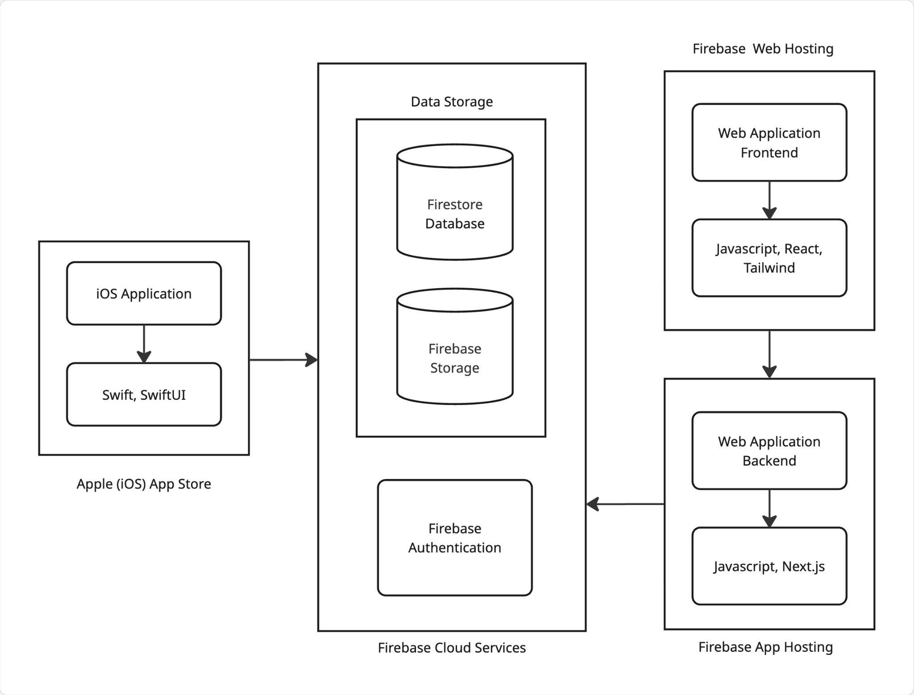
Overall Architecture
  Explanation
iOS Application: Users can submit lost and found item reports, and view approved reports from other users.
Web Application Frontend: Basic users can submit lost and found item reports, and view approved reports from other users. Administrators can approve and deny user-submitted item reports.
Web Application Backend: acts as a middleman for API calls send by the frontend.
Firebase Authentication: Allows users to sign in using their wit.edu Microsoft account.
Firestore Database: Stores user reports and other general text-based app data.
Firebase Storage: Stores user-submitted images.
Notes:
Craig

Slide 7
Components Mapping for Functional Requirements
Functional requirements | Mapped components
User registration via Wentworth Microsoft account. | Firebase Authentication
Search bar actions for user to search through list of found items. | React/SwiftUI, Firestore Database
View, edit or delete options for user reports. | React/SwiftUI, Firestore Database
Report a lost or found item(category, description, location, contact information, and optional image). | React/SwiftUI, Firestore Database, Firebase Storage
Notes:
Aliyan

Slide 8
Components Mapping for Non-Functional Requirements
Non-functional requirements | Mapped components
Access restricted to only @wit.edu accounts. | Firebase Authentication
All reports shall be saved in the database. | Firestore Database
All reports shall require item description, category, and location. | React/SwiftUI
Lost and found reports shall be approved by an administrator, before they are displayed in the app. | Firestore Database, Admin Dashboard
Notes:
Bjordi

Slide 9
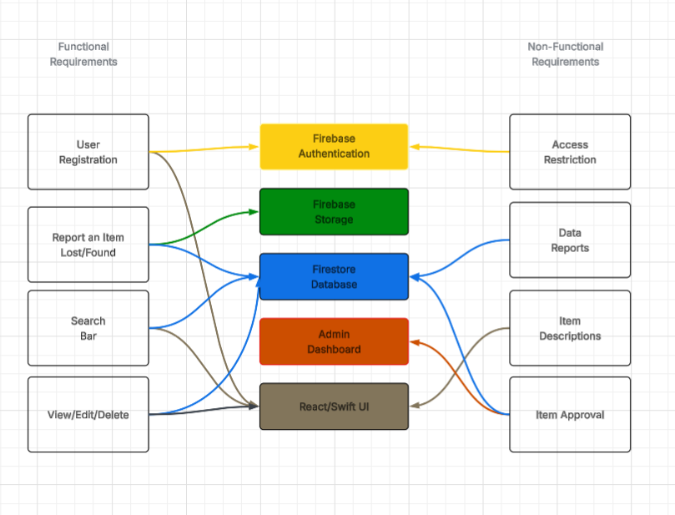
Components Map
Notes:
Sammy

Slide 10
Technology Stack Selection
Technology | Purpose
Firestore Database | Stores user reports and other general text-based app data.
Firebase Storage | Stores user-submitted images attached to lost/found reports.
Firebase Auth | Manages user sign-in, restricted to @wit.edu Microsoft accounts.
Firebase Hosting | Hosts the frontend and backend of the web application.
Javascript | Programming language that easily integrates required libraries for both frontend and backend.
Tailwind | CSS framework for rapidly styling the web application's frontend user interface.
React | JavaScript library for building the web app’s interactive UI components and dynamic pages.
Next.js | Framework used for server-side logic, routing, and acting as the API middleman
Visual Studio Code | Development environment used to build the web application’s frontend and backend.
Xcode | Development environment for developing, debugging, and compiling the iOS application.
Swift/SwiftUI | Programming language and native UI kit for building the iOS app.
Github and Jira | Development and collaboration tools used for tracking project progress.
Figma | Design tools used for UI mockups and visual diagrams like flowcharts and architecture.
Notes:
Aliyan

Slide 11
Q&A

